Slide 1
PROJECT NAME : TIC TAC TOE
NAME : SHAN BHOHARIA
Batch : CSE-BDA(sEM—2)
Enrollment no. : 21162121005
Subject : esfp-2

Slide 2
here I create a simple game of tic tac toe using C++ programming language
Tic-tac-toe is a game where two players X and O fill the hash (#) shaped box with their alternate turns.
The player who first fills the box with 3Xs or 3Os in a horizontal, vertical, or diagonal manner will win the game.
In some cases, when none of the players succeeds in filling the boxes horizontally, vertically, or diagonally with 3Xs or 3Os, then the game will be considered to be a draw.

Slide 3
WE creatED tic tac toe game using :
ARRAY
FUNCTION
TRUE-FALSE CONDTION

Slide 4
HEADER FILES OF PROJEECT :
#include <iostream>
#include <stdlib.h>

Slide 5
char board[3][3] = {{'1','2','3'},{'4','5','6'},{'7','8','9'}};
int choice;
int row,column;
char turn = 'X';
bool draw = false;
Created 2-D array for 3x3 borad
This section is variable declaration
Like char for ‘x’ and ‘0’ Boolean for true /false
Int for numbers

Slide 6
cout<<" | | \n";
cout<<" "<<board[0][0]<<" | "<<board[0][1]<<" | "<<board[0][2]<<" \n";
cout<<"_____|_____|_____\n";
cout<<" | | \n";
cout<<" "<<board[1][0]<<" | "<<board[1][1]<<" | "<<board[1][2]<<" \n";
cout<<"_____|_____|_____\n";
cout<<" | | \n";
cout<<" "<<board[2][0]<<" | "<<board[2][1]<<" | "<<board[2][2]<<" \n";
cout<<" | | \n";
}
void player_turn(){
if(turn == 'X'){
cout<<"\n\tPlayer - 1 [X] turn : ";
}
else if(turn == 'O'){
cout<<"\n\tPlayer - 2 [O] turn : ";
}
cin>> choice;
cout<<"PLAYER - 1 [X]\t PLAYER - 2 [O]\n\n";
Function to show the current status of the gaming board
void display_board(){

Slide 7
switch case to get which row and column will be update
switch(choice){
case 1: row=0; column=0; break;
case 2: row=0; column=1; break;
case 3: row=0; column=2; break;
case 4: row=1; column=0; break;
case 5: row=1; column=1; break;
case 6: row=1; column=2; break;
case 7: row=2; column=0; break;
case 8: row=2; column=1; break;
case 9: row=2; column=2; break;
default:
cout<<"Invalid Move";
}

Slide 8
If-else conditons ::
if(turn == 'X' && board[row][column] != 'X' && board[row][column] != 'O')
board[row][column] = 'X';
turn = 'O';
}else if(turn == 'O' && board[row][column] != 'X' && board[row][column] != 'O'){
board[row][column] = 'O';
turn = 'X';
}
else {
cout<<"Box already filled!n Please choose another!!\n\n";
player_turn();
}
display_board();
}

Slide 9
Using functions :
bool gameover(){
for(int i=0; i<3; i++)
if(board[i][0] == board[i][1] && board[i][0] == board[i][2] || board[0][i] == board[1][i] && board[0][i] == board[2][i])
return false;
if(board[0][0] == board[1][1] && board[0][0] == board[2][2] || board[0][2] == board[1][1] && board[0][2] == board[2][0])
return false;
for(int i=0; i<3; i++)
for(int j=0; j<3; j++)
if(board[i][j] != 'X' && board[i][j] != 'O')
return true;
draw = true;
return false;
}

Slide 10
int main()
{
cout<<"\t\t\tT I C K -- T A C -- T O E -- G A M E\t\t\t";
cout<<"\n\t\t\t\tFOR 2 PLAYERS\n\t\t\t";
while(gameover()){
display_board();
player_turn();
gameover();
}
if(turn == 'X' && draw == false){
cout<<"\n\nCongratulations!Player with '0' has won the game";
}
else if(turn == 'O' && draw == false){
cout<<"\n\nCongratulations!Player with 'x' has won the game";
}
else
cout<<"\n\nGAME DRAW!!!\n\n";
}

Slide 11
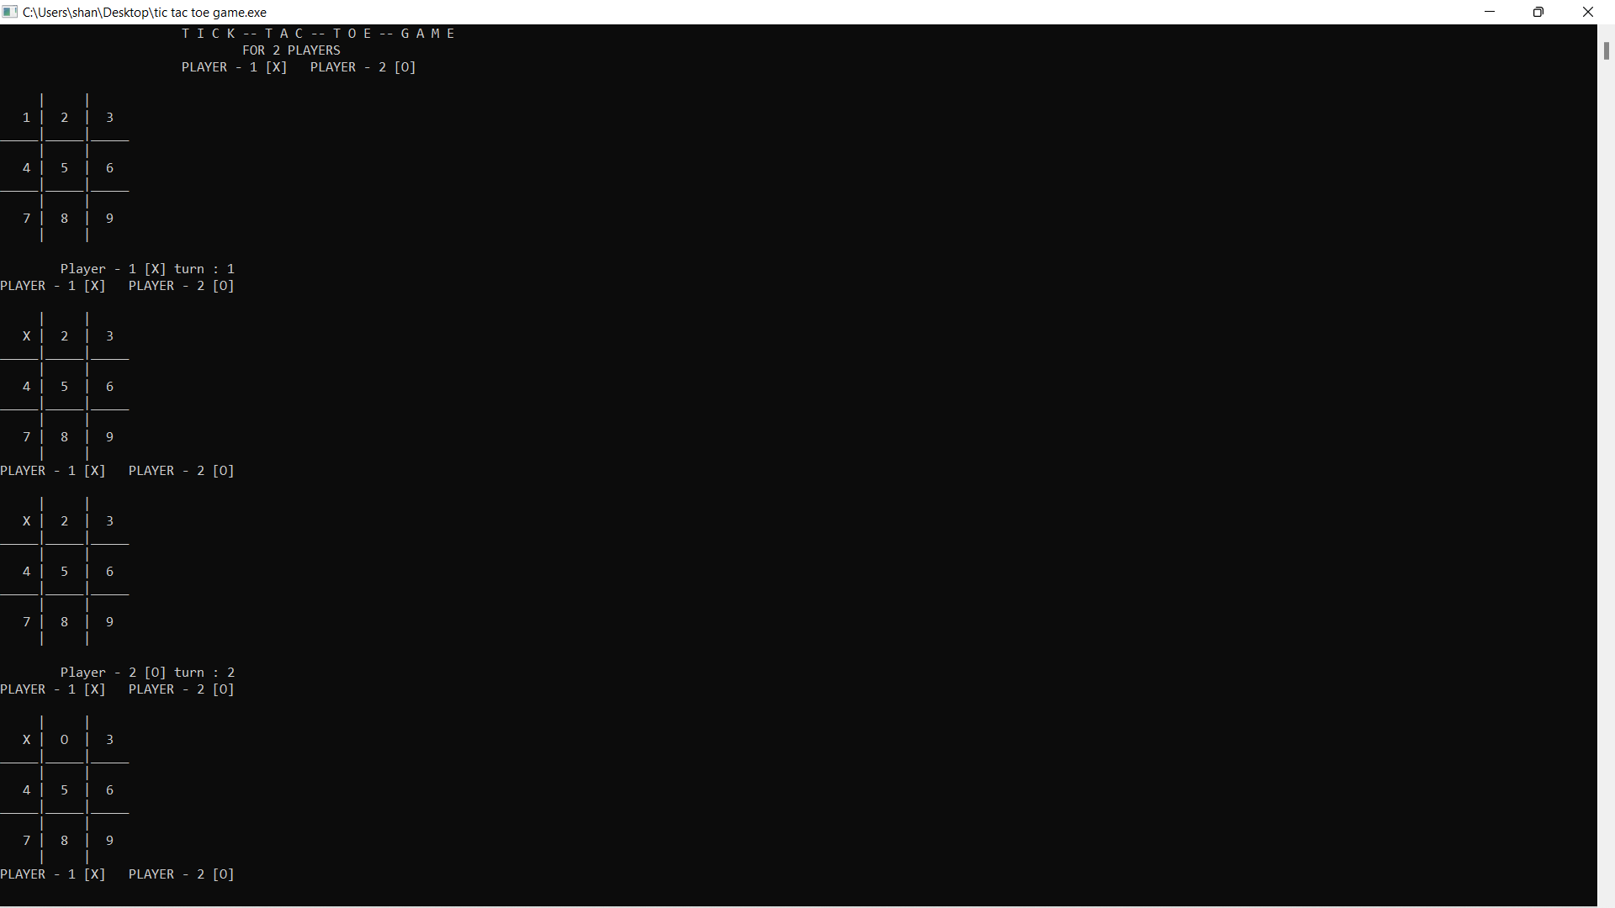
Output of game programe :

Slide 12
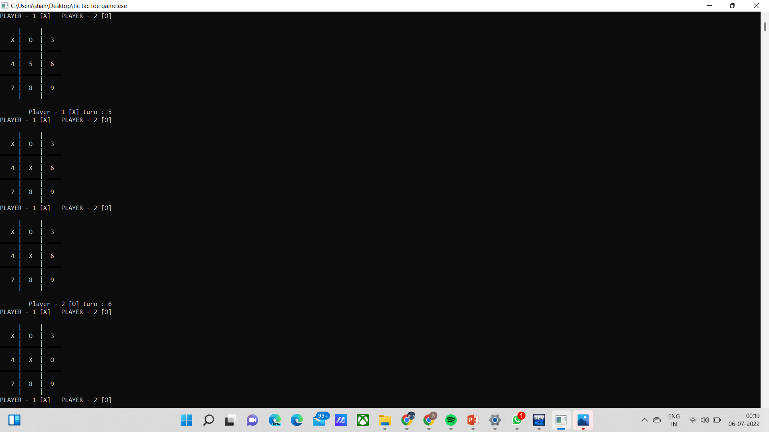

Slide 13
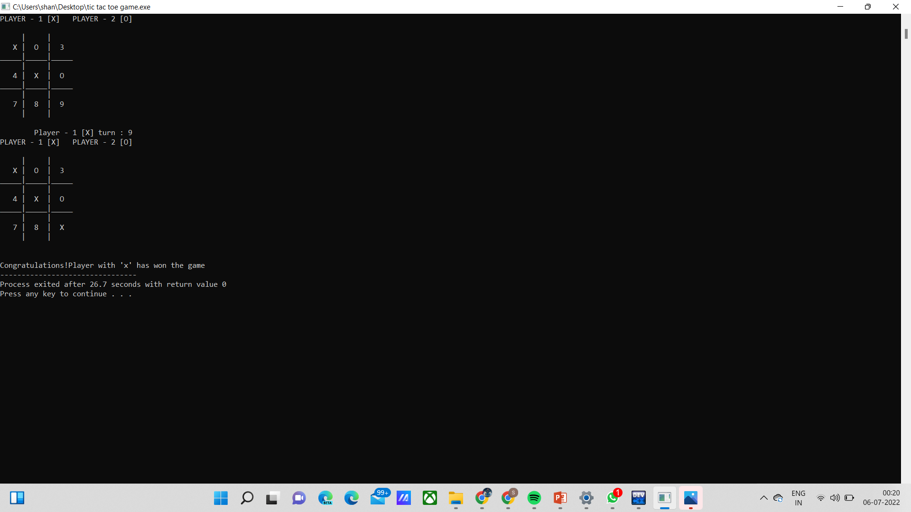

Slide 14
Thank you !
ppt created by Shan Bhoharia

